Slide 1
UNIT – 4
CONT…..

Slide 2
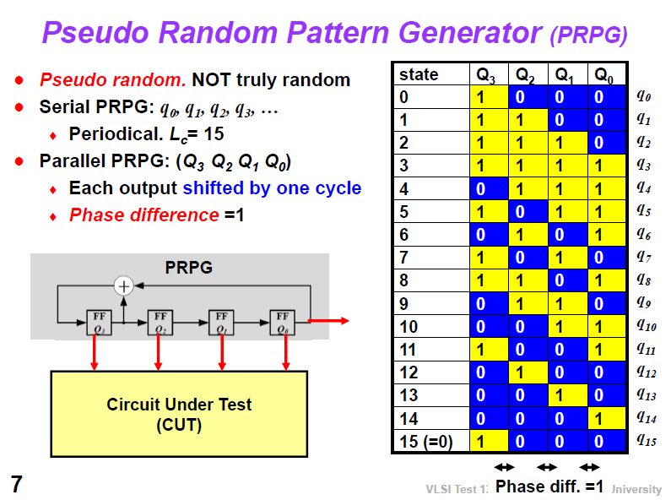

Slide 3
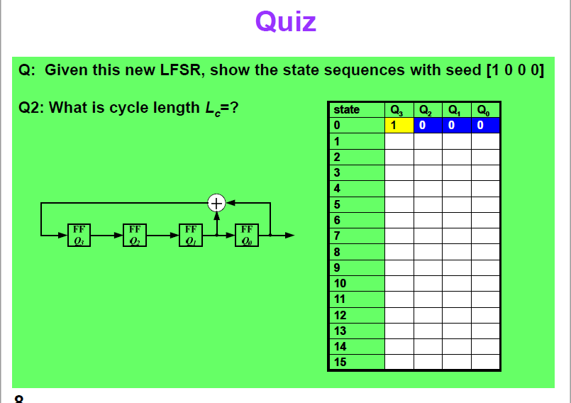

Slide 4
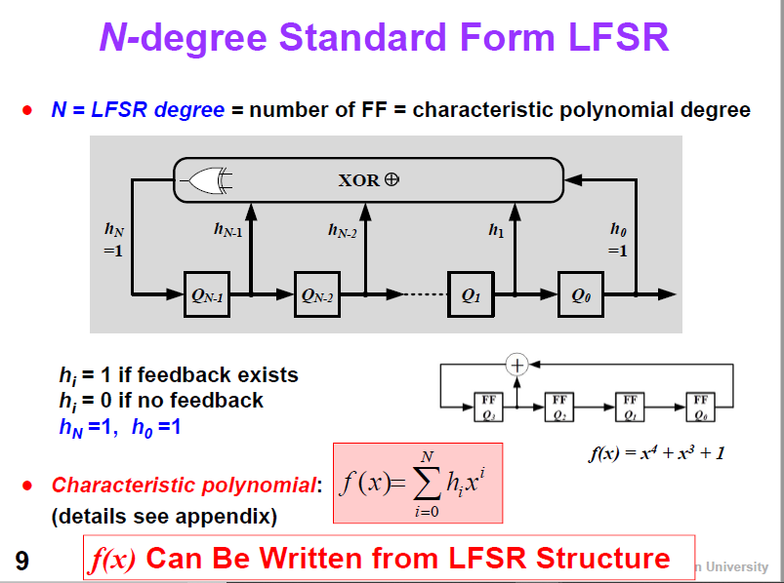

Slide 5
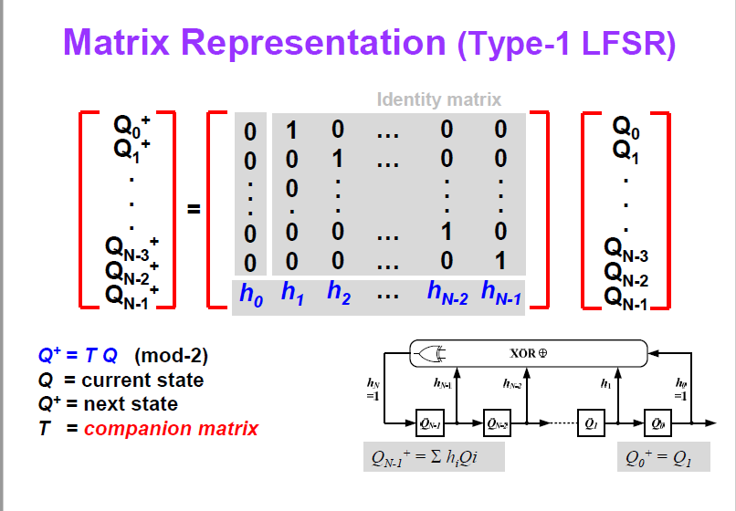

Slide 6
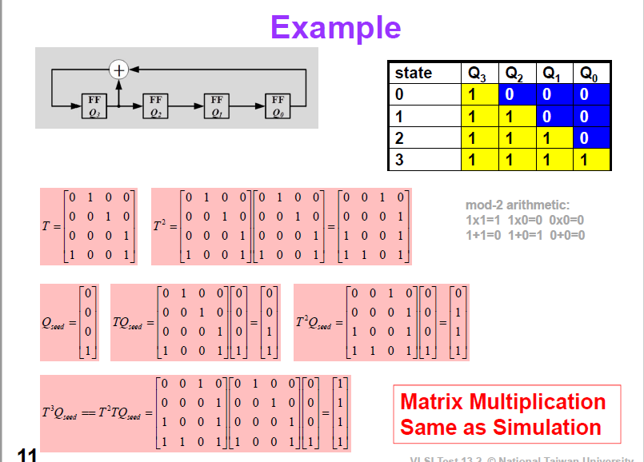

Slide 7
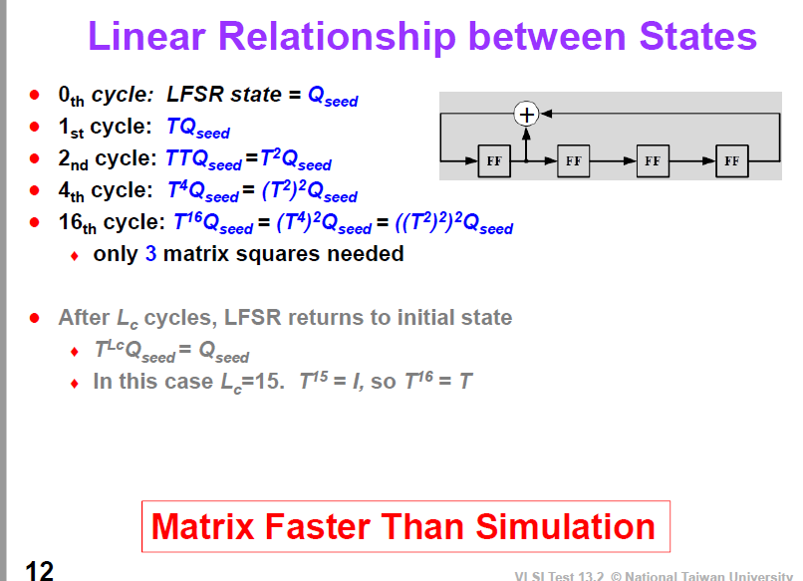

Slide 8
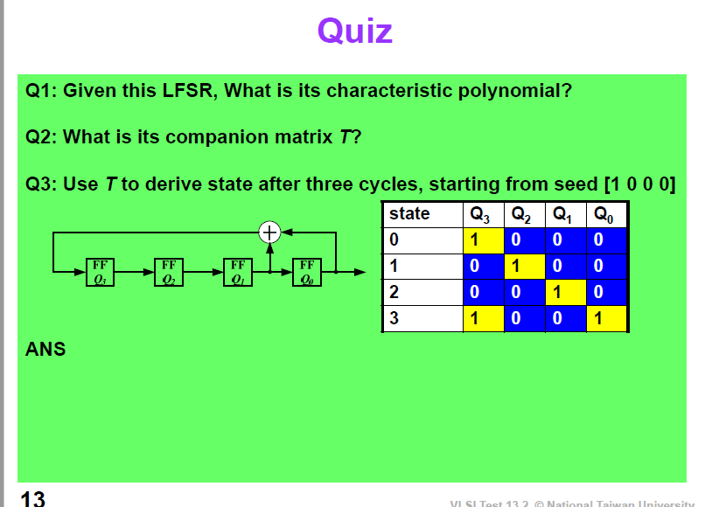

Slide 9
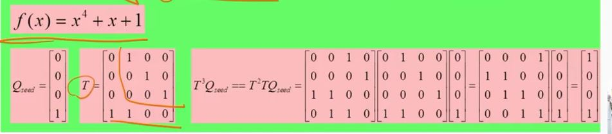

Slide 10
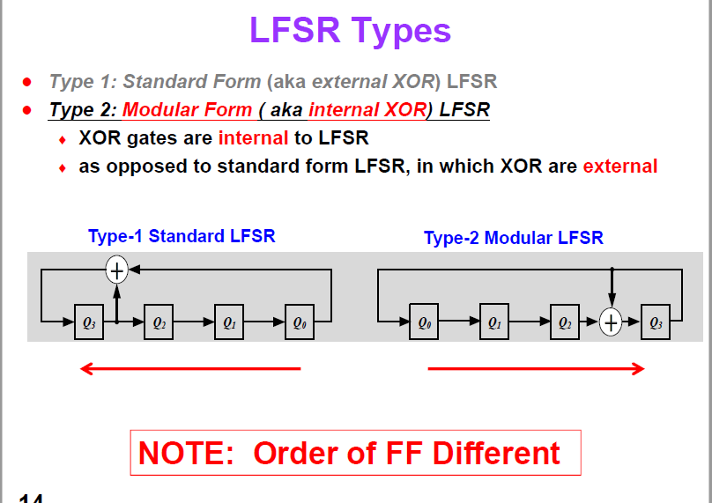

Slide 11
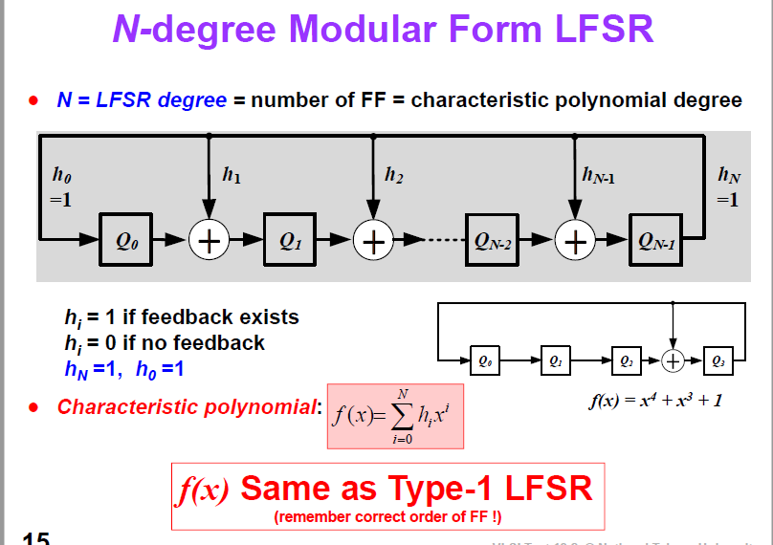

Slide 12
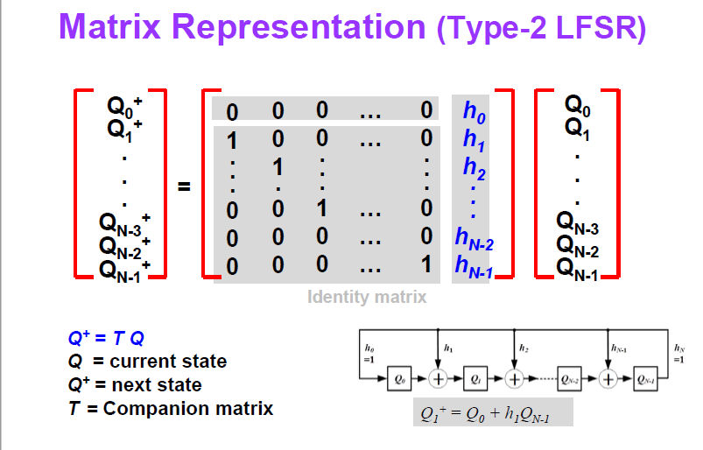

Slide 13
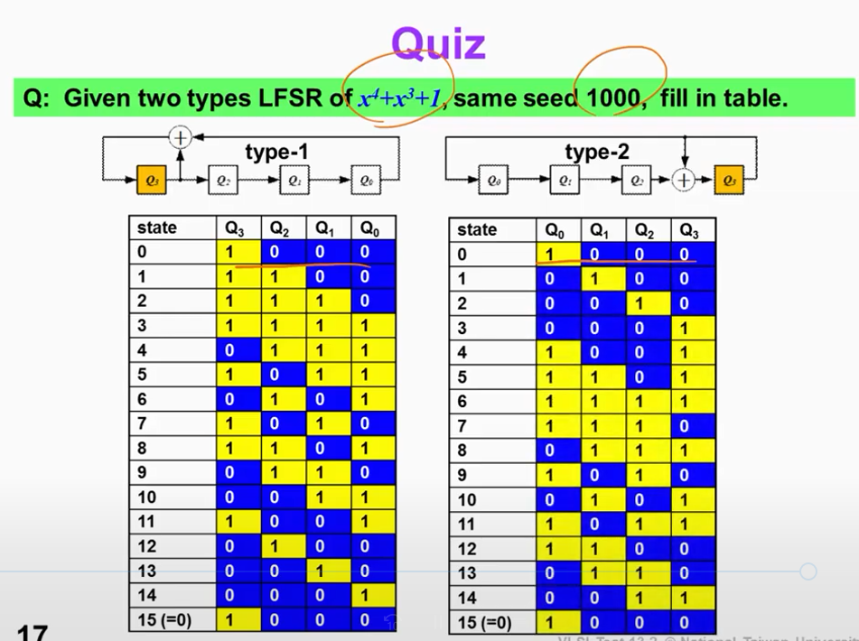

Slide 14
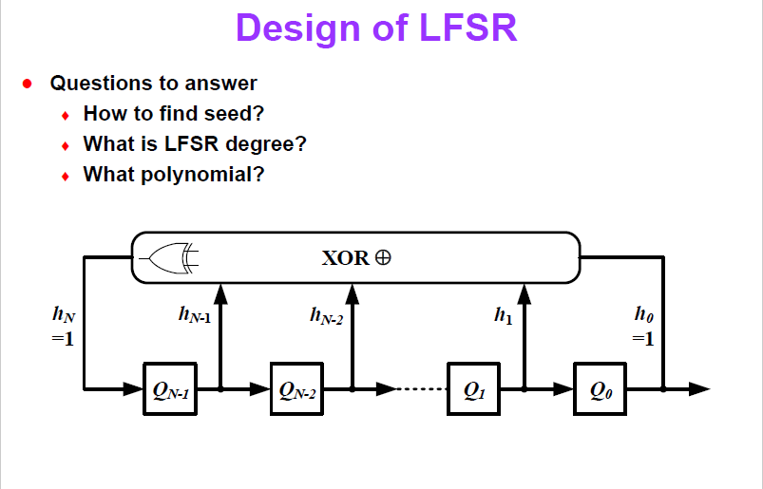

Slide 15
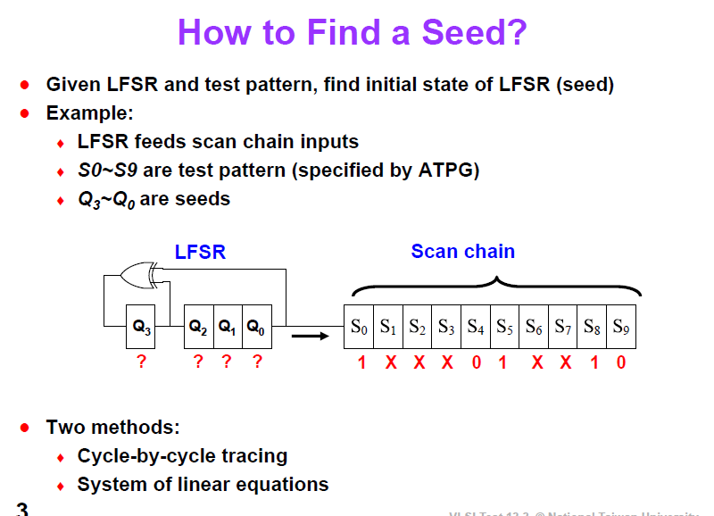

Slide 16
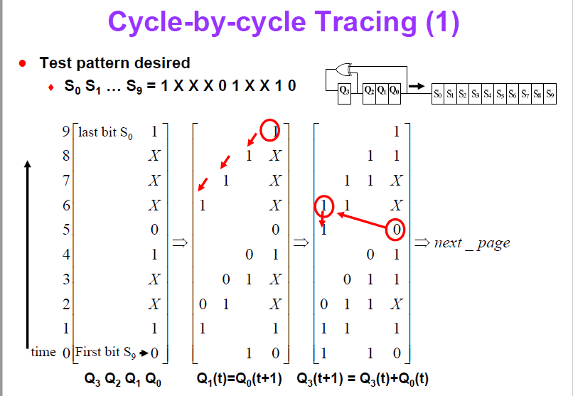

Slide 17
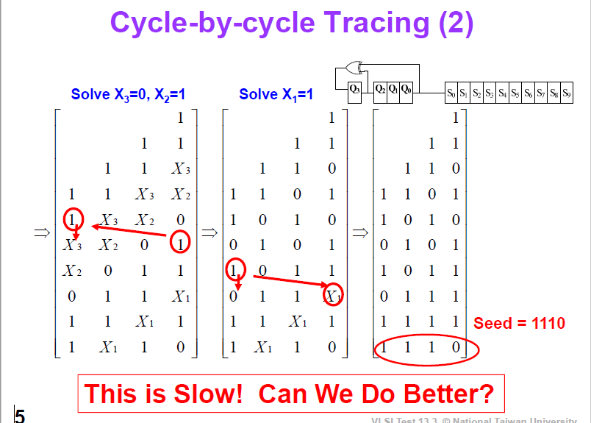

Slide 18
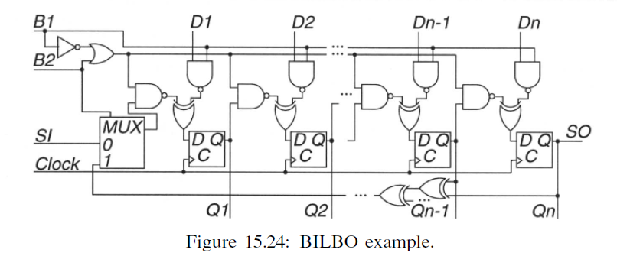
Built-In Logic Block Observers
the BILBO combines the functionality of the D flip-flop, a testing hardware pattern generator (for the circuit portion driven by the BILBO Q outputs), a testing response compacter (for the circuit portion driving the BILBO D inputs), and a scan chain function. The scan chain BILBO can be reset to zero by shifting in an all-zero pattern into the BILBO in serial scan chain mode.

Slide 19
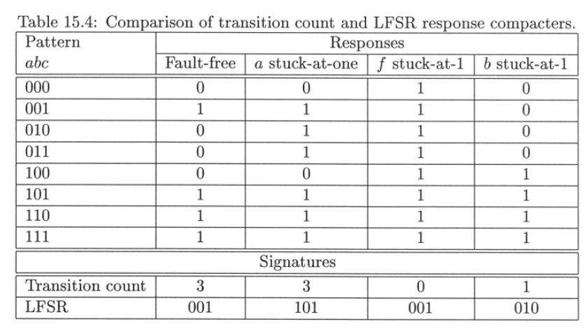
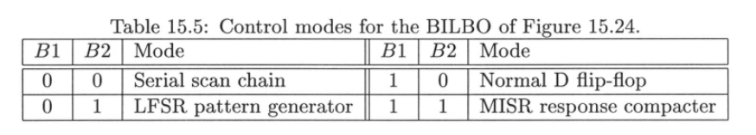

Slide 20
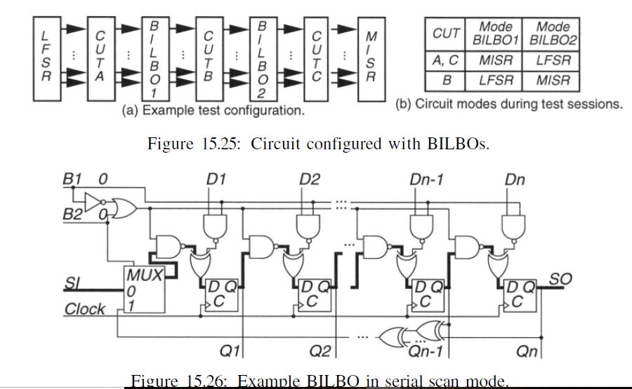
Figure 15.25(a) shows a testing configuration with three sub circuits to be tested, CUTA, CUTB, and CUTC; two BILBOs, BILBO1 and BILBO2; an input LFSR; and an output MISR for testing hardware.
Figure 15.25(b) shows how the testing hardware is used to test the three parts of the circuit.

Slide 21
Test-Per-Clock BIST Systems
In a test-per-clock BIST system, some new set of faults is tested during every clock period. The advantage of this BIST system is that it has the shortest possible pattern length, which may or may not be important.
Consider a BIST pattern sequence of 10 million vectors, applied at the system operating speed of 200 MHz.
Testing takes only 10,000,000 X 200X10^6 = 0.05s.
However, a major issue for BIST pattern length is fault simulation time. We can only know the actual fault coverage for a BISTed system from a stuck-fault simulation. The lengthy computation time worsens as the BIST pattern sequence increases, because the entire sequence must be simulated for the good machine and all failing machines.

Slide 22
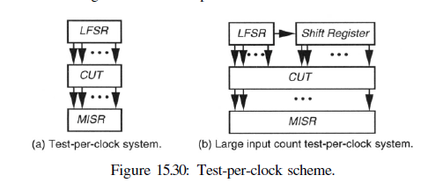
Figure 15.30(a) shows a test-per-clock system. In Figure 15.30(b) there are large numbers of PIs, so it is
feasible to apply an LFSR to a subset of these inputs and then serially shift the most significant bit coming out of the LFSR into a shift register to provide pattern stimulation for the remaining inputs. The saving in test hardware is extremely minor. The shift register portion of the circuit has the same flip-flop hardware as
the LFSR, but it lacks the few XOR gates used to form a LFSR feedback network.

Slide 23
Test-Per-Scan BIST Systems
In a test-per-scan BIST system, each new set of faults that is tested requires one clock to conduct the test and a series of shifts of the scan chain to complete that test and read out all of the test results. Test-per-scan, therefore, takes significantly more time than a test-per-clock method to detect the same number of faults in a given circuit.

Slide 24
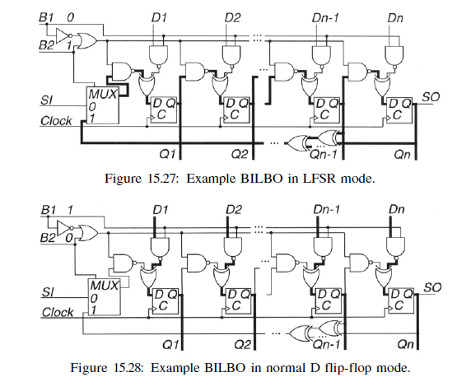

Slide 25
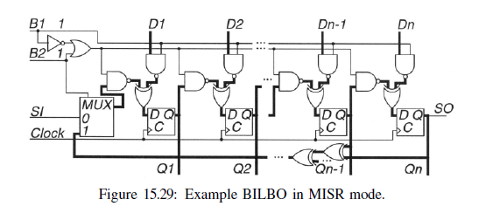
One problem in test-per-scan systems is that usually a new set of circuit input patterns is generated using a pseudo-random or exhaustive technique. However, because the input patterns are time shifted and repeated to the circuit through the scan chain, the patterns become correlated. This, in turn, reduces the pattern effectiveness for fault detection, so very frequently it is necessary to provide an input network of XOR gates to phase shift the inputs and de-correlate them.

